Slide 1
Name : Muhammad Rukhsar P20-0085 Decorator pattern

Slide 2
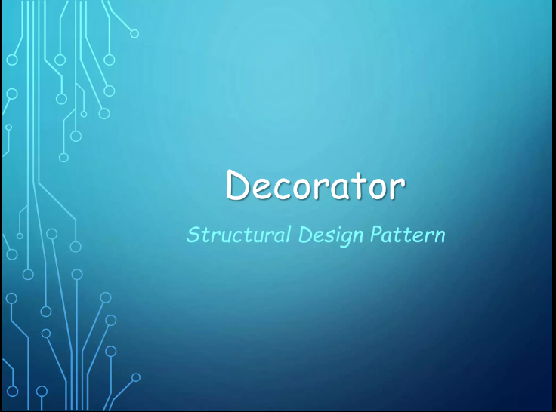

Slide 3
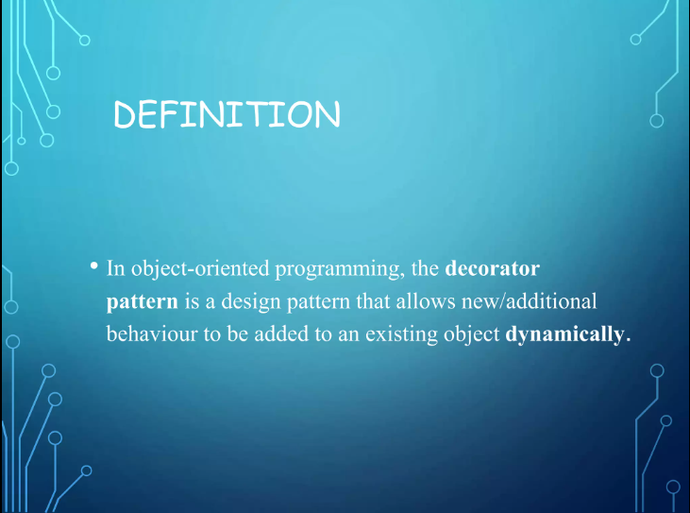

Slide 4
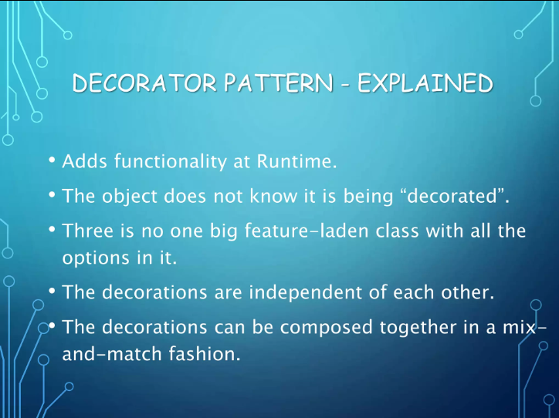

Slide 5
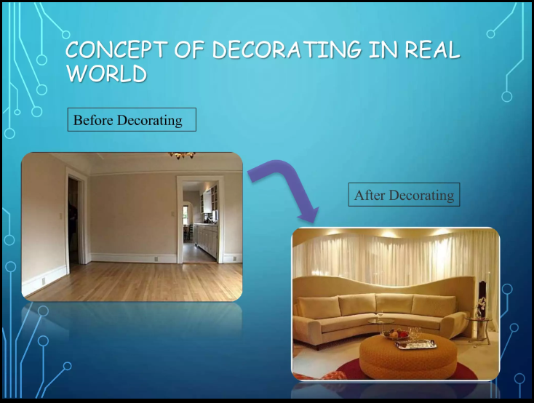

Slide 6


Slide 7
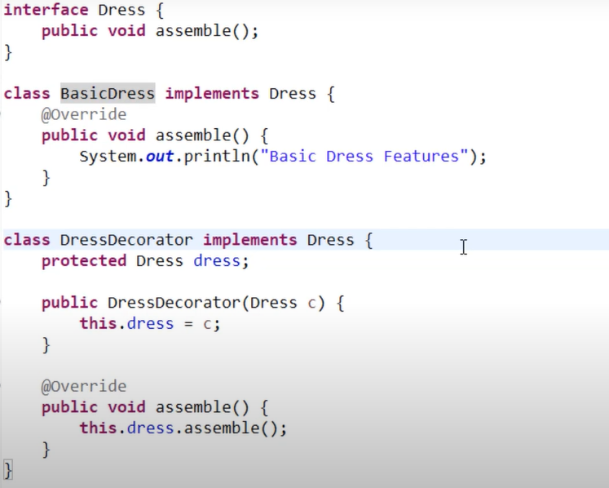

Slide 8
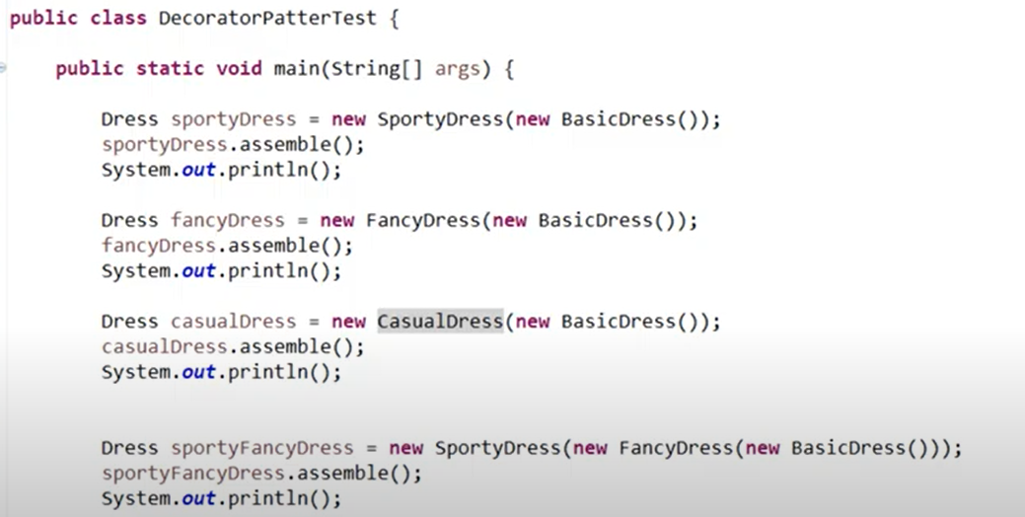

Slide 9
Advantage:
It provides greater flexibility
Disadvantage
Code maintainability because this pattern creates lots of similar decorators

